Slide 1
MODULE 5 Introduction to ARDUINO Programming and Smart Connected cities

Slide 2
Arduino:
Arduino is an open-source prototyping platform which depend on simple to utilize equipment and programming.
It is easy- to-use hardware and software.
Arduino boards are able to read inputs – such as detecting power of light, events triggered by a button or a twitter message and can respond into a yield.
Instructions to the microcontroller are given by the use of the Arduino programming dialect which depend on writing and handled through the utilization of Arduino Software.

Slide 3
Why Arduino
Arduino is an open source product, software/hardware which is accessible and flexible to customers.
Flexible because of offering variety of digital and analog pins.
It is easy to use, connected to a computer via a USB and communicates using serial protocol.
Inexpensive with free authoring software.
It is Cross-platform
Arduino follows simple, clear programming.

Slide 4
Arduino UNO:
Arduino Uno is a microcontroller board based on the ATmega328P.
It has 14 digital input/output pins (of which 6 can be used as PWM outputs), 6 analog inputs, a 16 MHz quartz crystal, a USB connection, a power jack, an ICSP header and a reset button.
"Uno" means one in Italian and was chosen to mark the release of Arduino Software (IDE) 1.0. The Uno board and version 1.0 of Arduino Software (IDE) were the reference versions of Arduino, now evolved to newer releases.

Slide 5
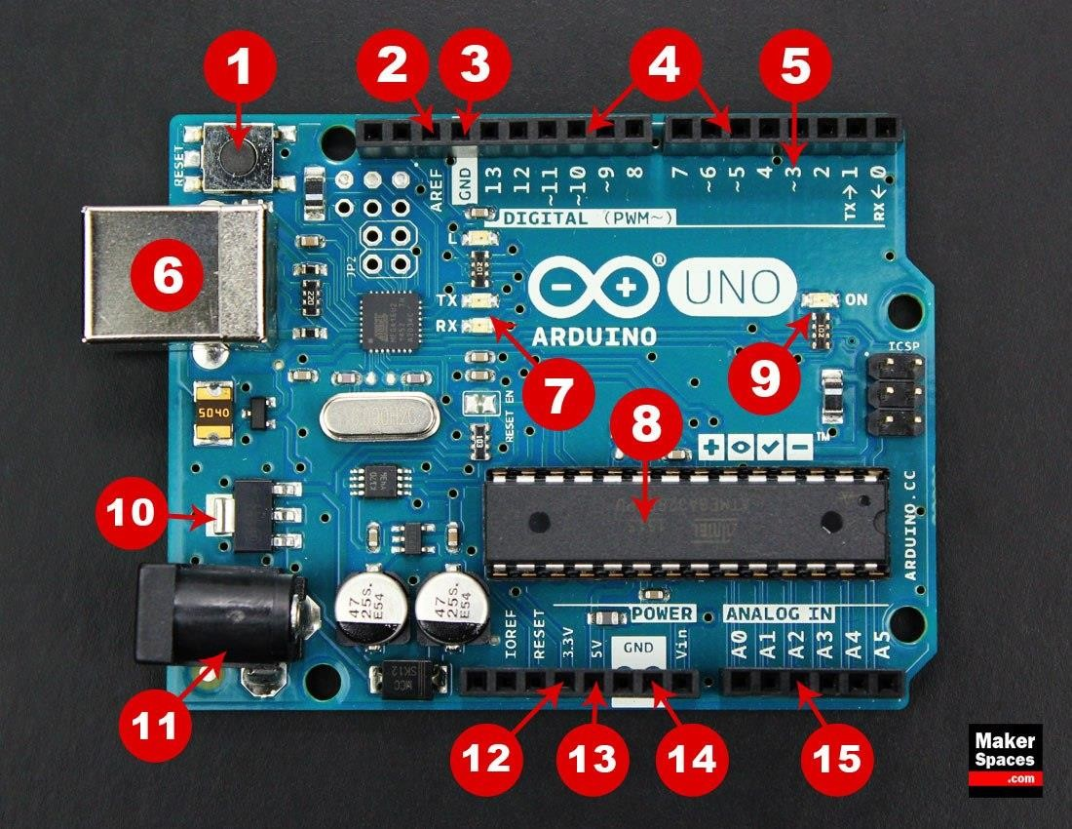
Arduino UNO Learning Board:

Slide 6
Arduino UNO Learning Board: Pins
Reset button: when u press this button, the program that is currently being run in your Arduino will start from the beginning. There is a Reset pin next to the power pins that acts as reset button. When we apply a small voltage to that pin, it will reset the Arduino.
AREF : Stands for “Analog Reference” and is used to set an external reference voltage.
Ground Pin – There are a few ground pins on the Arduino and they all work the same.
Digital Input/Output – Pins 0-13 can be used for digital input or output. When set as inputs, these pins can read voltage. They can read two different states high and low. When set as outputs, these pins apply voltage. They can apply 5V(high) or 0V(low).
PWM – The pins marked with the (~) symbol can simulate analog output.
USB Connection – Used for powering up your Arduino and uploading sketches.

Slide 7
Arduino UNO Learning Board: Pins
TX and RX pins: These pins blink when there are information being sent between the computer and the Arduino. Transmit and receive data indication LEDs.
ATmega328p Microcontroller – This is the brains and is where the programs are stored. Everything on the Arduino board is meant to support this microcontroller.
Power LED Indicator – This LED lights up anytime the board is plugged in a power source.
Voltage Regulator – This controls the amount of voltage going into the Arduino board.
DC Power Barrel Jack – This is used for powering your Arduino with a power supply.
3.3V Pin – This pin supplies 3.3 volts of power to your projects output
5V Pin – This pin supplies 5 volts of power to your projects
15. Analog Pins – These pins can read the signal from an analog sensor and convert it to digital.

Slide 8
Module – 5 IoT Physical Devices and End Point-Aurdino Uno
Fundamentals of Arduino Programming:
Two required functions / methods / routines:
void setup()
{
// runs once
}
void loop()
{
// repeats
}

Slide 9
Concepts of Programming
DigitalWrite( )
AnalogWrite( )
DigitalRead( )
AnalogRead( )
If( ) statements
Delay( )

Slide 10
COMMENTS
// this is for single line comments
/* this is for multi-line comments */

Slide 11
Commands to know
pinMode(pin, INPUT/OUTPUT);
ex: pinMode(13, OUTPUT);
digitalWrite(pin, HIGH/LOW);
ex: digitalWrite(13, HIGH);
delay(time_ms);
ex: delay(2500); // delay of 2.5 sec.
Commands are case-sensitive

Slide 12
Arduino code basics
Arduino programs run on two basic sections:
void setup()
{
//setup motors, sensors etc
}
void loop()
{
// get information from sensors
// send commands to motors
}

Slide 13
SETUP
The setup section is used for assigning input and outputs (Examples: motors, LED’s, sensors etc) to ports on the Arduino.
It also specifies whether the device is OUTPUT or INPUT. To do this we use the command “pinMode”.

Slide 14
SETUP
void setup() {
port #
pinMode(9, OUTPUT);
Input or Output
}

Slide 15
LOOP
void loop() {
Port # from setup
digitalWrite(9, HIGH); delay(1000); digitalWrite(9, LOW); delay(1000);
Turn the LED on
or off
}
Wait for 1 second
or 1000 milliseconds

Slide 16
DECLARING A VARIABLE
int val = 5;
assignment “becomes”
variable name
Type
value

Slide 17
USING VARIABLES
int delayTime = 2000;
int greenLED = 9;
void setup() {
Declare delayTime
^{pinMode(greenLED, OUTPUT);}Variable
}
void loop() {
digitalWrite(greenLED, HIGH);
delay(delayTime);
digitalWrite(greenLED, LOW)
delay(delayTime);
Use delayTime
}

Slide 18
Using Variables
int delayTime = 2000; int greenLED = 9;
void setup() {
pinMode(greenLED, OUTPUT);
}
void loop() {
digitalWrite(greenLED, HIGH); delay(delayTime); digitalWrite(greenLED, LOW);
delayTime = delayTime - 100; delay(delayTime);
subtract 100 from
}
delayTime to gradually increase LED’s blinking speed

Slide 19
Conditions
To make decisions in Arduino code we use an ‘if’ statement
‘If’ statements are based on a TRUE or FALSE question

Slide 20
VALUE COMPARISONS
GREATER THAN
GREATER THAN OR EQUAL
a > b
a >= b
LESS
LESS THAN OR EQUAL
a < b
a <= b
EQUAL
NOT EQUAL
a == b
a != b

Slide 21
IF Condition
if(true)
{
“perform some action”
}

Slide 22

IF Example
int counter = 0;
void setup() { Serial.begin(9600);
}
void loop() {
if(counter < 10)
{
Serial.println(counter);
}
counter = counter + 1;
}

Slide 23

Input & Output
Transferring data from the computer to an Arduino is done using Serial Transmission
To setup Serial communication we use the following
void setup() { Serial.begin(9600);
}
26

Slide 24
Writing to the Console
void setup() {
Serial.begin(9600);
Serial.println(“Hello World!”);
}
void loop() {}

Slide 25
IF-ELSE Condition
if( “answer is true”)
{
“perform some action”
}
else
{
“perform some other action”
}

Slide 26
IF-ELSE Example
int counter = 0;
void setup() {
Serial.begin(9600);
}
void loop() {
if(counter < 10)
{
Serial.println(“less than 10”);
}
else
{
Serial.println(“greater than or equal to 10”);
Serial.end();
}
counter = counter + 1;
}

Slide 27
IF-ELSE IF Condition
if( “answer is true”)
{
“perform some action”
}
else if( “answer is true”)
{
“perform some other action”
}
Else
{
}

Slide 28
IF-ELSE IF Example
int counter = 0;
void setup() {
Serial.begin(9600);
}
void loop() {
if(counter < 10)
{
Serial.println(“less than 10”);
}
else if (counter == 10)
{
Serial.println(“equal to 10”);
}
else
{
Serial.println(“greater than 10”);
Serial.end();
}
counter = counter + 1;
}

Slide 29
BOOLEAN operators AND
If we want all of the conditions to be true we need to use ‘AND’ logic (AND gate)
We use the symbols &&
Example: if ( val > 10 && val < 20)

Slide 30
BOOLEAN operators OR
If we want either of the conditions to be true we need to use ‘OR’ logic (OR gate)
We use the symbols ||
Example: if ( val < 10 || val > 20)

Slide 31
Important functions
Serial.println(value);
Prints the value to the Serial Monitor on your computer
pinMode(pin, mode);
Configures a digital pin to read (input) or write (output) a digital value
digitalRead(pin);
Reads a digital value (HIGH or LOW) on a pin set for input
digitalWrite(pin, value);
Writes the digital value (HIGH or LOW) to a pin set for output

Slide 32
OUTLINE
Essential Programming Concepts
Delay
Infinite Loop
General Input/Output
Polling or Busy/Wait I/O
Interrupt Processing
Timers and Internal Interrupts
High-Level Language Extensions
Code Transformations for Embedded Computing
Loop Unrolling
Loop Merging
Loop Peeling
Loop Tiling

Slide 33
DELAY
Delays are essential in embedded systems, unlike high-performance systems where we want the program to execute as fast as possible
Delays are used to synchronize events, or read inputs with a specific sampling frequency (more on Bus/Wait I/O)

Slide 34
Infinite Loop
Embedded Systems are mostly single-functioned
Their core application never terminates
Infinite loops are not forbidden as long as they are done correctly.

Slide 35
Infinite Loop
void main()
{
light enum {RED, ORANGE, GREEN};
loop: light = RED; //no exit from loop! delay(20000); //20-sec red
light = ORANGE;
delay(2000); light = GREEN; delay(20000); goto loop;
//2-sed orange
//20-sec green
//just repeat sequence
}

Slide 36
Introduction to Raspberry Pi

Slide 37
Raspberry Pi
Raspberry Pi is the name of a series of single-board computers made by the Raspberry Pi Foundation, a UK charity that aims to educate people in computing and create easier access to computing education.
The Raspberry Pi launched in 2012, and there have been several iterations and variations released since then. The original Pi had a single-core 700MHz CPU and just 256MB RAM, and the latest model has a quad-core 1.4GHz CPU with 1GB RAM. The main price point for Raspberry Pi has always been $35 and all models have been $35 or less, including the Pi Zero, which costs just $5.

Slide 38
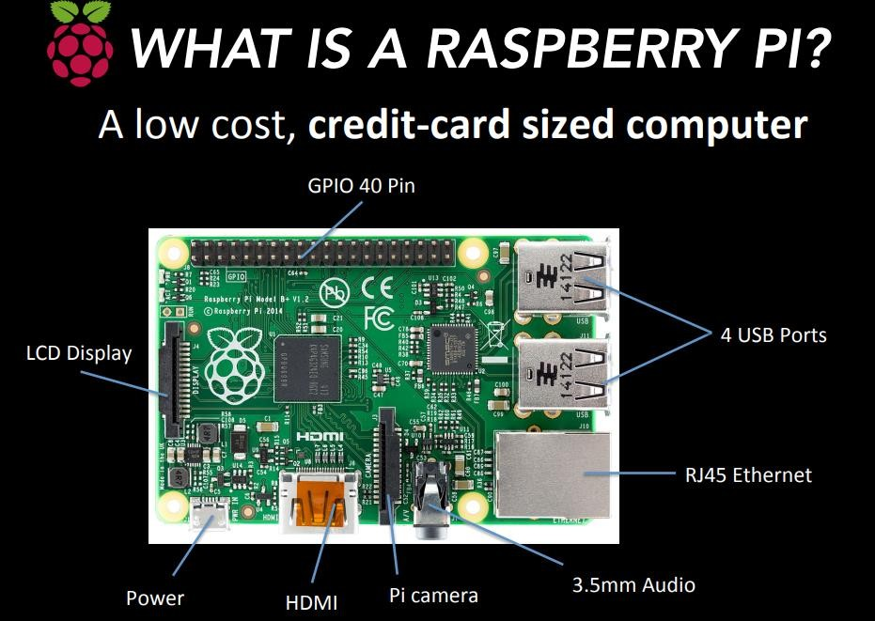

Slide 39
Raspberry Pi
Processor: The Broadcom BCM2835 SOC is used in first generation. It included 700MHz ARM processor, Graphical Processing Unit and RAM. L1 cache is 16KB and L2 cache is 128KB. The Raspberry Pi 2 uses a Broadcom BCM2836 SoC with 900 MHz 32-bit quad-core ARM cortex A7 processor, which 256 KB shared L2 cache. The Raspberry Pi 3 uses a Broadcom BCM2837 SoC with a 1.2 GHz 64-bit quad core ARM Cortex A53 processor , with a 512KB shared L2 cache.
Power source: Raspberry Pi is powered by using USB port on the side of the unit. Input voltage is 5V and input current is 2A.
SD Card: The working framework is stacked on a SD card which is embedded on the SD card space on the Raspberry Pi.
HDMI: High Definition Multimedia Interface to give both video and sound yield.

Slide 40
Raspberry Pi
GPIO: General purpose input and output is a non specific pins on a coordinated circuit to know which is an input or output pin which can be controlled by the client at the run time. Capabilities of GPIO are:
GPIO pins can be designed to be input or output
GPIO pins can be empowered/crippled
Input values can be high or low
Yield values are writable/meaningful
Display: The Raspberry Pi connector S2 is a DSI (Display Serial Interface) for connecting a LCD panel using a 15-pin ribbon cable.
Audio Jack: A standard 3.5mm TRS connector is accessible on the RPi for stereo sound yield.
Ethernet port: It is accessible on Model B and B+. It can be associated with a system or web utilizing a standard LAN link on the Ethernet port. This ports are controlled by Microchip LAN9512 LAN controller chip.

Slide 41
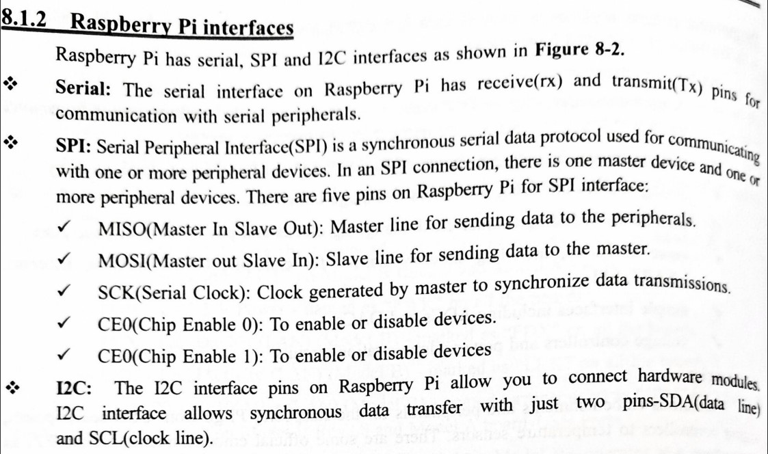
Raspberry Pi Interface

Slide 42
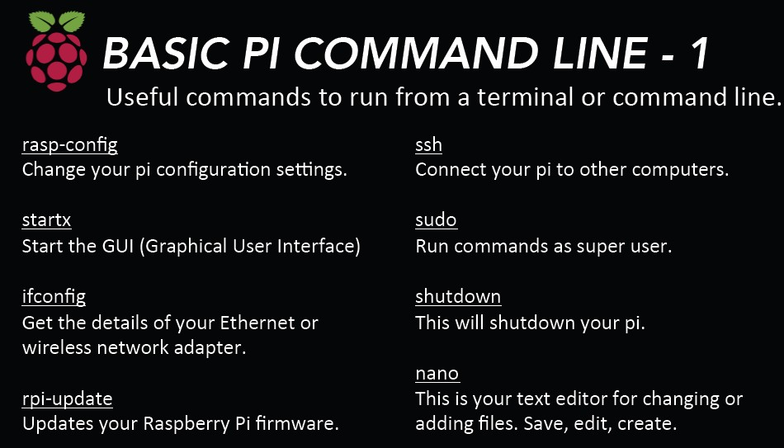

Slide 43
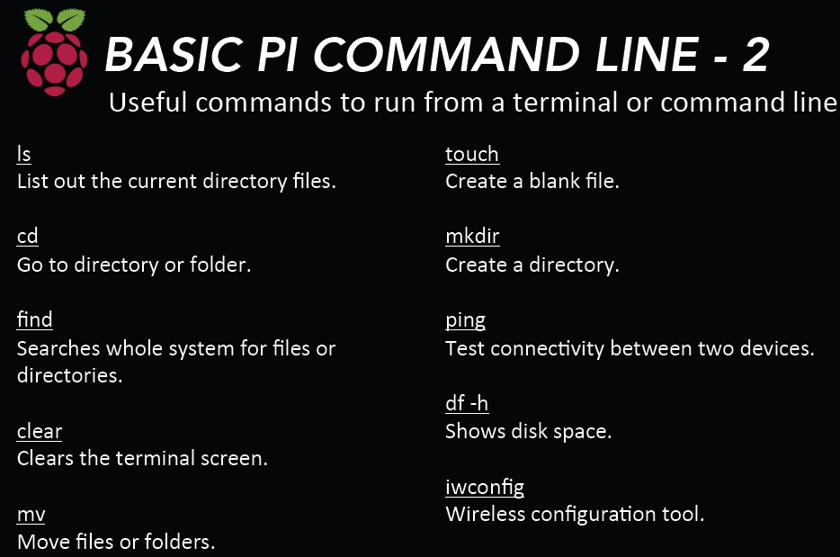

Slide 44
Hardware Layout of Raspberry Pi
raspi-config
The Raspberry Pi configuration tool in Raspbian, allowing you to easily enable features such as the camera, and to change your specific settings such as keyboard layout.
config.txt
The Raspberry Pi configuration file. Wireless networking
Configuring your Pi to connect to a wireless network using the Raspberry Pi 3's or Pi Zero W's inbuilt wireless
connectivity, or a USB wireless dongle.
Wireless access point
Configuring your Pi as a wireless access point using the Raspberry Pi 3 and Pi Zero W's inbuilt wireless connectivity, or a USB wireless dongle.

Slide 45
Hardware Layout of Raspberry Pi
Using a proxy
Setting up your Pi to access the internet via a proxy server
HDMI Config
Guide to setting up your HDMI device, including custom settings
Audio config
Switch your audio output between HDMI and the 3.5mm jack Camera config
Installing and setting up the Raspberry Pi camera board
External storage config
Mounting and setting up external storage on a Raspberry Pi

Slide 46
Hardware Layout of Raspberry Pi
Localisation
Setting up your Pi to work in your local language/time zone Default pin configuration
Changing the default pin states. Device Trees config
Device Trees, overlays, and parameters Kernel command line
How to set options in the kernel command line UART configuration
How to set up the on-board UARTS.
Firmware warning icons
Description of warning icons displayed if the firmware detects issues

Slide 47
Hardware Layout of Raspberry Pi
LED warning flash codes
Description of the meaning of LED warning flashes that are shown if a Pi
fails to boot or has to shut down
Securing your Raspberry Pi
Some basic advice for making your Raspberry Pi more secure
Screensaver
How to configure screen blanking/screen saver
The boot folder
What it's for and what's in it

Slide 48
Programming RaspberryPi with Python:
The Raspberry Pi is an amazing single board computer (SBC) capable of running Linux and a whole host of applications. Python is a beginner-friendly programming language that is used in schools, web development, scientific research, and in many other industries.

Slide 49
Operating System on Raspberry Pi
OS (not Linux based)
RISC OS Pi
FreeBSD
NetBSD
PLAN 9 from Bell Labs and Inferno
Windows 10 IOT core
Xv6(unix os)

Slide 50
Operating System on Raspberry Pi
OS (linux based)
Xbian
Raspberry Pi fedora remix
Pidora
Diet Pi
Kano OS
Media center OS
OSMC
OpenElec
Xbian
Rasplex
Audio OS
Recalbox

Slide 51
Operating System on Raspberry Pi
Audio OS
Volumnio
Pimusicbox
Runeaudio
moOdeaudio
Recalbox
Happy Game Center
Lakka
ChameleonPi
Piplay

Slide 52
Wireless Temperature Monitoring System Using Pi:
Raspberry Pi which having inbuilt wi-fi, which makes Raspberry Pi to suitable for IoT applications, so that by using IoT technology this monitoring system works by uploading the temperature value to the Thingspeak cloud by this project you can able to learn to how to handle cloud-based application using API keys.
In this monitoring system, we used Thingspeak cloud, the cloud which is suitable to view the sensor logs in the form of graph plots.
Here we created one field to monitor the temperature value, that can be reconfigurable to monitor a number of sensor values in various fields. This basic will teach you to how to work with a cloud by using LM35 as a temperature sensor, to detect the temperature and to upload those values into the cloud.

Slide 53
Wireless Temperature Monitoring System Using Pi:
HARDWARE REQUIRED
Raspberry Pi
SD card
Power supply
VGA to HDMI converter (Optional)
MCP3008 (ADC IC)
A temperature sensor(LM35)
SOFTWARE REQUIRED
Raspbian Stretch OS
SD card Formatter
Win32DiskImager (or) Etcher
PYTHON LIBRARIES USED
RPi.GPIO as GPIO (To access the GPIO Pins of
Raspberry Pi)
Time library (For Time delay)
Urllib2 to handle URL using Python programming

Slide 54
DS18B20 Temperature Sensor
The DS18B20 is a 1-wire programmable Temperature sensor from maxim integrated. It is widely used to measure temperature in hard environments like in chemical solutions, mines or soil etc.
The construction of the sensor is rugged and also can be purchased with a waterproof option making the mounting process easy. It can measure a wide range of temperature from -55°C to +125° with a decent accuracy of ±5°C.
Each sensor has a unique address and requires only one pin of the MCU to transfer data so it a very good choice for measuring temperature at multiple points without compromising much of your digital pins on the microcontroller.

Slide 55
DS18B20 Temperature Sensor
Applications:
Measuring temperature at hard environments
Liquid temperature measurement
Applications where temperature has to be measured at multiple points
Pin Configuration:
No | Pin Name | Description
1 | Ground | Connect to the ground of the circuit
2 | Vcc | Powers the Sensor, can be 3.3V or 5V
3 | Data | This pin gives output the temperature value which can be read using 1-wire method
4

Slide 56
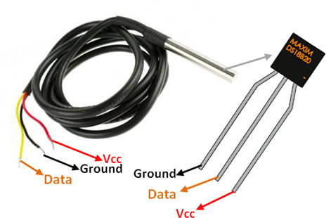
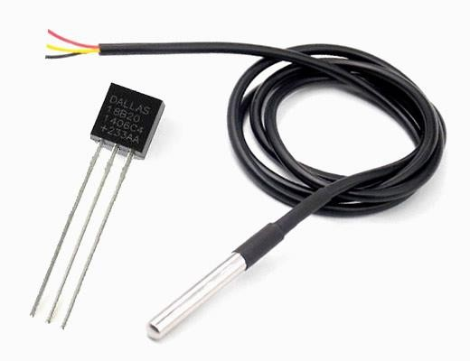
DS18B20 Temperature Sensor
DS18B20 Temperature Sensor Pinout
DS18B20 Temperature Sensor

Slide 57
Connecting Raspberry Pi via SSH:
You can access the command line of a Raspberry Pi remotely from another computer or device on the same network using SSH. The Raspberry Pi will act as a remote device: you can connect to it using a client on another machine.
Set up your local network and wireless connectivity
Enable SSH
Enable SSH on a headless Raspberry Pi (add file to SD card on another machine)
Set up your client

Slide 58
Accessing Temperature from DS18B20 sensors:
The DS18B20 is a digital thermometer that allows to get 9-bit to 12-bit Celsius temperature measurements (programmable resolution). The temperature conversion time depends on the resolution used. For a 9-bit resolution it takes at most 93.75 ms and for a 12-bit resolution it takes at most 750 ms. The device is able to measure temperatures from -55°C to +125°C and has a ±0.5°C accuracy in the range from -10°C to +85°C.
Additionally, it has an alarm functionality with programmable upper and lower temperature trigger points. These thresholds are stored internally in non-volatile memory, which means they are kept even if the device is powered off.
The sensor communicates using the OneWire protocol, which means it only requires a pin from a microcontroller to be connected to it. Furthermore, each sensor has a unique 64-bit serial code, allowing multiple DS18B20 devices to function on the same OneWire bus. In terms of power supply, the device can operate with a voltage between 3.0 V and 5.5 V, which means it can operate with the same voltage of the ESP32 without the need for level conversion.

Slide 59
Smart City IoT Architecture:
A smart city IoT infrastructure is a four-layered architecture, as shown in Figure Data flows from devices at the street layer to the city network layer and connect to the data center layer, where the data is aggregated, normalized, and virtualized.
The data center layer provides information to the services layer, which consists of the applications that provide services to the city.
In smart cities, multiple services may use IoT solutions for many different purposes. These services may use different IoT solutions, with different protocols and different application languages.

Slide 60
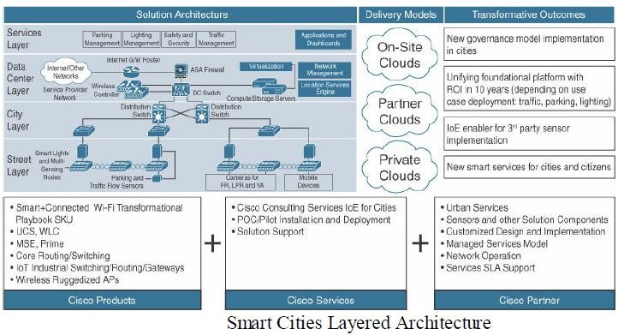
Smart City IoT Architecture:

Slide 61
Smart City IoT Architecture:
Street Layer:
The street layer is composed of devices and sensors that collect data and take action based on instructions from the overall solution, as well as the networking components needed to aggregate and collect data.
A sensor is a data source that generates data required to understand the physical world. Sensor devices are able to detect and measure events in the physical world.
ICT connectivity solutions rely on sensors to collect the data from the world around them so that it can be analyzed and used to operationalize use cases for cities.

Slide 62
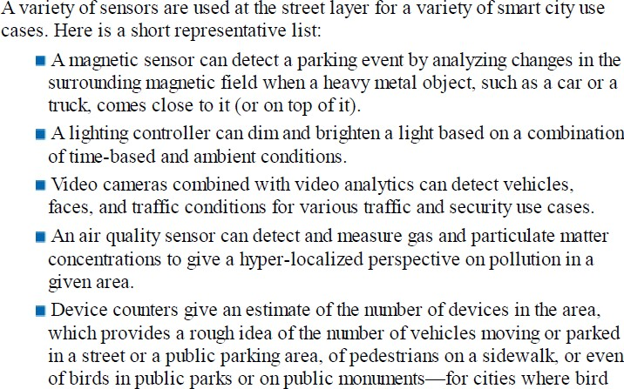
Smart City IoT Architecture

Slide 63
Smart City IoT Architecture
City Layer:
At the city layer, which is above the street layer, network routers and switches must be deployed to match the size of city data that needs to be transported.
This layer aggregates all data collected by sensors and the end-node network into a single transport network.
The city layer may appear to be a simple transport layer between the edge devices and the data center or the Internet.
However, one key consideration of the city layer is that it needs to transport multiple types of protocols, for multiple types of IoT applications. Some applications are delay- and jitter sensitive, and some other applications require a deterministic approach to frame delivery.
A missed packet may generate an alarm or result in an invalid status report. As a result, the city layer must be built around resiliency, to ensure that a packet coming from a sensor or a gateway will always be forwarded successfully to the headend station.

Slide 64
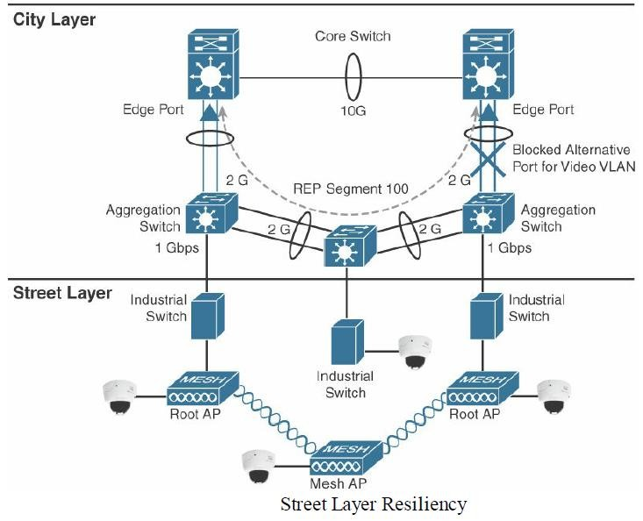
Smart City IoT Architecture:

Slide 65
Smart City IoT Architecture:
City Layer:
In this model, at least two paths exist from any aggregation switch to the data center layer. A common protocol used to ensure this resiliency is Resilient Ethernet Protocol (REP).

Slide 66
Smart City IoT Architecture:
Data Center Layer:
Ultimately, data collected from the sensors is sent to a data center, where it can be processed and correlated.
Based on this processing of data, meaningful information and trends can be derived, and information can be provided back.
For example, an application in a data center can provide a global view of the city traffic and help authorities decide on the need for more or less common transport vehicles. At the same time, an automated response can be generated.

Slide 67
Smart City IoT Architecture:
Data Center Layer:
The cloud model is the chief means of delivering storage, virtualization, adaptability, and the analytics know-how that city governments require for the technological mashup and synergy of information embodied in a smart city.
Traditional city networks simply cannot keep up with the real-time data needs of smart cities, they are encumbered by their physical limitations.
The cloud enables data analytics to be taken to server farms with large and extensible processing capabilities.

Slide 68
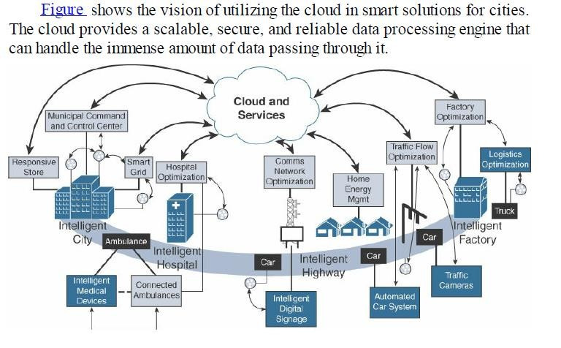
Smart City IoT Architecture:
Data Center Layer:

Slide 69
Smart City IoT Architecture:
Service Layer:
Ultimately, the true value of ICT connectivity comes from the services that the measured data can provide to different users operating within a city.
Smart city applications can provide value to and visibility for a variety of user types, including city operators, citizens, and law enforcement.
The collected data should be visualized according to the specific needs of each consumer of that data and the particular user experience requirements and individual use cases.

Slide 70
Smart City Security Architecture
A serious concern of most smart cities and their citizens is data security.
Vast quantities of sensitive information are being shared at all times in a layered, real-time architecture, and cities have a duty to protect their citizens’ data from unauthorized access, collection, and tampering.
In general, citizens feel better about data security when the city itself, and not a private entity, owns public or city-relevant data.
It is up to the city and the officials who run it to determine how to utilize this data.
A security architecture for smart cities must utilize security protocols to fortify each layer of the architecture and protect city data.
Figure shows a reference architecture, with specific security elements highlighted.
Security protocols should authenticate the various components and protect data transport throughout.

Slide 71
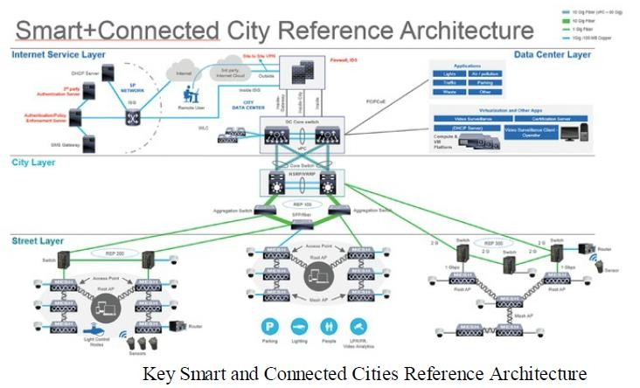
Module – 5 Smart City Security Architecture
Smart City Security Architecture:

Slide 72
Smart City Security Architecture
Starting from the street level, sensors should have their own security protocols.
Some industry-standard security features include device/sensor identification and authorization; device/sensor data encryption; Trusted Platform Module, which enables self-destruction when the sensor is physically handled; and user ID authentication and authorization.
Sensor identification and authorization typically requires a pre-installed factory X.509 certificate and public key infrastructure (PKI) at the organization level, where a new certificate is installed through a zero-touch deployment process.
This additional processing may slow the deployment but ensures the security of the exchanges.
Another consideration may be the type of data that the sensor is able to collect and process. For example, a roadside car counter may include a Bluetooth sensor that uniquely identifies each driver or pedestrian.

Slide 73
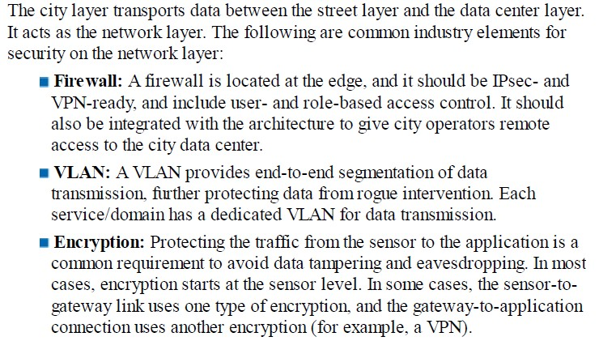
Smart City Security Architecture
Smart City Security Architecture:

